Slide 1

K-MEANS
DISUSUN OLEH:
RAMA PRAMUDYA WIBISANA 2022320019
LIDIANI GARI 2022320066

Slide 2
LANGKAH K-MEANS
Siapkan dataset
Tentukan jumlah cluster (k)
Pilih titik centroid secara acak
Kelompokkan data sehingga terbentuk (K) buah cluster dengan titik centroid dari setiap cluster
Perbarui nilai titik centroid
Ulangi Langkah 3 sampai 5 sampai nilai titik centroid tidak lagi berubah

Slide 3
LANGKAH PENYELESAIAN
BLOK | RT 1 | RT 2
BLOK A | 6 | 10
BLOK B | 8 | 5
BLOK C | 5 | 4
BLOK D | 6 | 8
BLOK E | 3 | 6
BLOK F | 4 | 2
BLOK G | 7 | 9
BLOK H | 2 | 6
BLOK I | 10 | 3
BLOK J | 5 | 2
BLOK K | 9 | 6
BLOK L | 8 | 5
BLOK M | 2 | 5
BLOK N | 4 | 3
BLOK O | 5 | 8
CENTROID | RT 1 | RT 2 | SIMBOL
C1 | 2 | 4
C2 | 5 | 8
C3 | 9 | 7

Slide 4
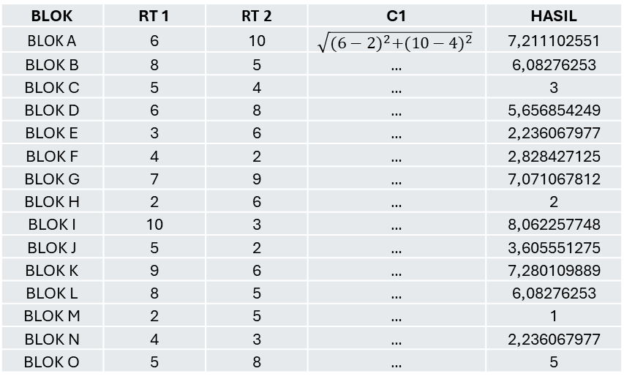
PENGELOMPOKKAN DATA
CENTROID | RT 1 | RT 2
C1 | 2 | 4
BLOK | RT 1 | RT 2 | C1 | HASIL
BLOK A | 6 | 10 | $$\sqrt{{(6−2)}^{2}+{(10−4)}^{2}}$$ | 7,211102551
BLOK B | 8 | 5 | … | 6,08276253
BLOK C | 5 | 4 | … | 3
BLOK D | 6 | 8 | … | 5,656854249
BLOK E | 3 | 6 | … | 2,236067977
BLOK F | 4 | 2 | … | 2,828427125
BLOK G | 7 | 9 | … | 7,071067812
BLOK H | 2 | 6 | … | 2
BLOK I | 10 | 3 | … | 8,062257748
BLOK J | 5 | 2 | … | 3,605551275
BLOK K | 9 | 6 | … | 7,280109889
BLOK L | 8 | 5 | … | 6,08276253
BLOK M | 2 | 5 | … | 1
BLOK N | 4 | 3 | … | 2,236067977
BLOK O | 5 | 8 | … | 5

Slide 5
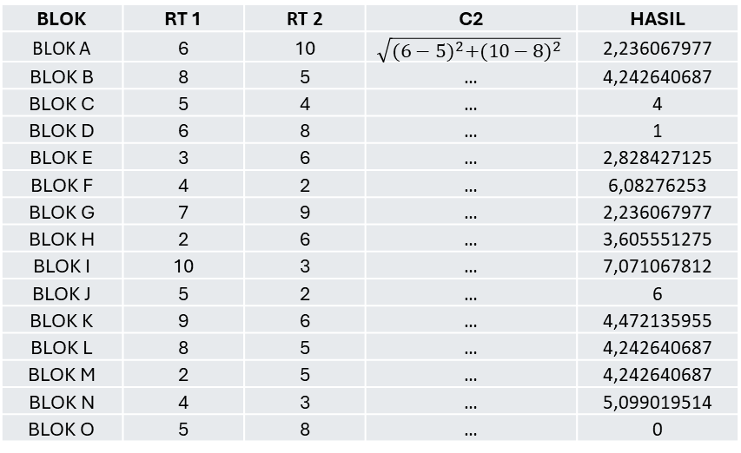
PENGELOMPOKKAN DATA
CENTROID | RT 1 | RT 2
C2 | 5 | 8
BLOK | RT 1 | RT 2 | C2 | HASIL
BLOK A | 6 | 10 | $$\sqrt{{(6−5)}^{2}+{(10−8)}^{2}}$$ | 2,236067977
BLOK B | 8 | 5 | … | 4,242640687
BLOK C | 5 | 4 | … | 4
BLOK D | 6 | 8 | … | 1
BLOK E | 3 | 6 | … | 2,828427125
BLOK F | 4 | 2 | … | 6,08276253
BLOK G | 7 | 9 | … | 2,236067977
BLOK H | 2 | 6 | … | 3,605551275
BLOK I | 10 | 3 | … | 7,071067812
BLOK J | 5 | 2 | … | 6
BLOK K | 9 | 6 | … | 4,472135955
BLOK L | 8 | 5 | … | 4,242640687
BLOK M | 2 | 5 | … | 4,242640687
BLOK N | 4 | 3 | … | 5,099019514
BLOK O | 5 | 8 | … | 0

Slide 6
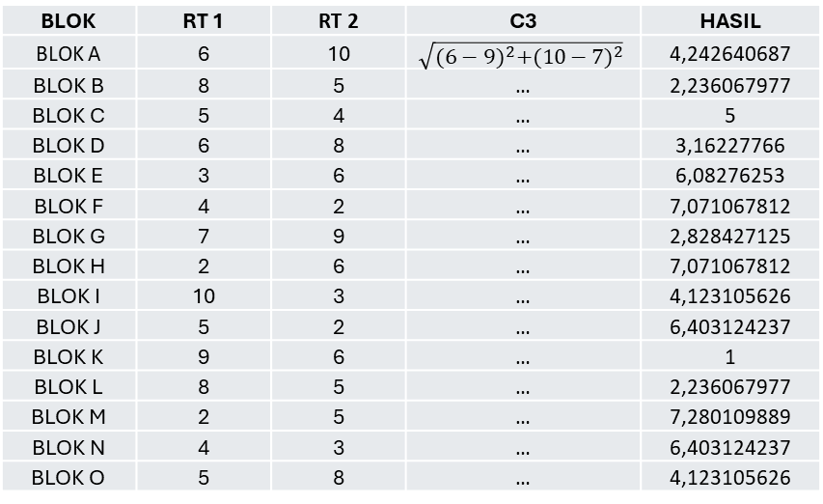
PENGELOMPOKKAN DATA
CENTROID | RT 1 | RT 2
C3 | 9 | 7
BLOK | RT 1 | RT 2 | C3 | HASIL
BLOK A | 6 | 10 | $$\sqrt{{(6−9)}^{2}+{(10−7)}^{2}}$$ | 4,242640687
BLOK B | 8 | 5 | … | 2,236067977
BLOK C | 5 | 4 | … | 5
BLOK D | 6 | 8 | … | 3,16227766
BLOK E | 3 | 6 | … | 6,08276253
BLOK F | 4 | 2 | … | 7,071067812
BLOK G | 7 | 9 | … | 2,828427125
BLOK H | 2 | 6 | … | 7,071067812
BLOK I | 10 | 3 | … | 4,123105626
BLOK J | 5 | 2 | … | 6,403124237
BLOK K | 9 | 6 | … | 1
BLOK L | 8 | 5 | … | 2,236067977
BLOK M | 2 | 5 | … | 7,280109889
BLOK N | 4 | 3 | … | 6,403124237
BLOK O | 5 | 8 | … | 4,123105626

Slide 7
PENGELOMPOKKAN DATA
BLOK | RT 1 | RT 2 | C1 | C2 | C3 | CENTROID
BLOK A | 6 | 10 | 7,211102551 | 2,236067977 | 4,242640687 | 2
BLOK B | 8 | 5 | 6,08276253 | 4,242640687 | 2,236067977 | 3
BLOK C | 5 | 4 | 3 | 4 | 5 | 1
BLOK D | 6 | 8 | 5,656854249 | 1 | 3,16227766 | 2
BLOK E | 3 | 6 | 2,236067977 | 2,828427125 | 6,08276253 | 1
BLOK F | 4 | 2 | 2,828427125 | 6,08276253 | 7,071067812 | 1
BLOK G | 7 | 9 | 7,071067812 | 2,236067977 | 2,828427125 | 2
BLOK H | 2 | 6 | 2 | 3,605551275 | 7,071067812 | 1
BLOK I | 10 | 3 | 8,062257748 | 7,071067812 | 4,123105626 | 3
BLOK J | 5 | 2 | 3,605551275 | 6 | 6,403124237 | 1
BLOK K | 9 | 6 | 7,280109889 | 4,472135955 | 1 | 3
BLOK L | 8 | 5 | 6,08276253 | 4,242640687 | 2,236067977 | 3
BLOK M | 2 | 5 | 1 | 4,242640687 | 7,280109889 | 1
BLOK N | 4 | 3 | 2,236067977 | 5,099019514 | 6,403124237 | 1
BLOK O | 5 | 8 | 5 | 0 | 4,123105626 | 2

Slide 8
MEMPERBARUI CENTROID
CENTROID LAMA | RT 1 | RT 2
C1 | 2 | 4
C2 | 5 | 8
C3 | 9 | 7
CENTROID BARU | RT 1 | RT 2
C1 | 3,571428571 | 4
C2 | 6 | 8,75
C3 | 8,75 | 4,75
C1X = $\frac{1}{7}\left(5+3+4+2+5+2+4\right)=3,571428571$
C1Y = $\frac{1}{7}\left(4+6+2+6+2+5+3\right)=4$
C2X = $\frac{1}{4}\left(6+6+7+5\right)=6$
C2Y = $\frac{1}{4}\left(10+8+9+8\right)=8,75$
C3X = $\frac{1}{4}\left(8+10+9+8\right)=8,75$
C3Y = $\frac{1}{4}\left(5+3+6+5\right)=4,75$

Slide 9
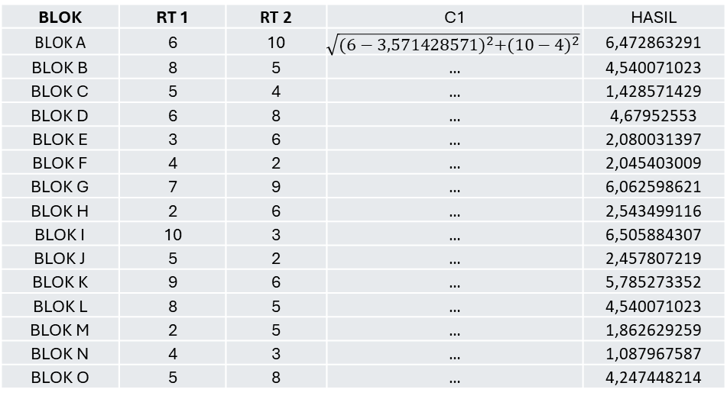
PENGELOMPOKKAN DATA CENTROID BARU
CENTROID | RT 1 | RT 2
CENTROID BARU 1 | 3,571428571 | 4
BLOK | RT 1 | RT 2 | C1 | HASIL
BLOK A | 6 | 10 | $$\sqrt{{(6−3,571428571)}^{2}+{(10−4)}^{2}}$$ | 6,472863291
BLOK B | 8 | 5 | … | 4,540071023
BLOK C | 5 | 4 | … | 1,428571429
BLOK D | 6 | 8 | … | 4,67952553
BLOK E | 3 | 6 | … | 2,080031397
BLOK F | 4 | 2 | … | 2,045403009
BLOK G | 7 | 9 | … | 6,062598621
BLOK H | 2 | 6 | … | 2,543499116
BLOK I | 10 | 3 | … | 6,505884307
BLOK J | 5 | 2 | … | 2,457807219
BLOK K | 9 | 6 | … | 5,785273352
BLOK L | 8 | 5 | … | 4,540071023
BLOK M | 2 | 5 | … | 1,862629259
BLOK N | 4 | 3 | … | 1,087967587
BLOK O | 5 | 8 | … | 4,247448214

Slide 10
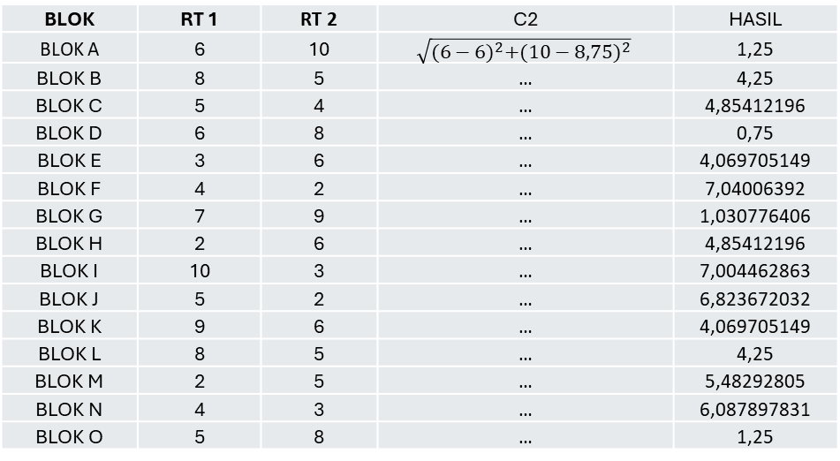
PENGELOMPOKKAN DATA CENTROID BARU
CENTROID | RT 1 | RT 2
CENTROID BARU 2 | 6 | 8,75
BLOK | RT 1 | RT 2 | C2 | HASIL
BLOK A | 6 | 10 | $$\sqrt{{(6−6)}^{2}+{(10−8,75)}^{2}}$$ | 1,25
BLOK B | 8 | 5 | … | 4,25
BLOK C | 5 | 4 | … | 4,85412196
BLOK D | 6 | 8 | … | 0,75
BLOK E | 3 | 6 | … | 4,069705149
BLOK F | 4 | 2 | … | 7,04006392
BLOK G | 7 | 9 | … | 1,030776406
BLOK H | 2 | 6 | … | 4,85412196
BLOK I | 10 | 3 | … | 7,004462863
BLOK J | 5 | 2 | … | 6,823672032
BLOK K | 9 | 6 | … | 4,069705149
BLOK L | 8 | 5 | … | 4,25
BLOK M | 2 | 5 | … | 5,48292805
BLOK N | 4 | 3 | … | 6,087897831
BLOK O | 5 | 8 | … | 1,25

Slide 11
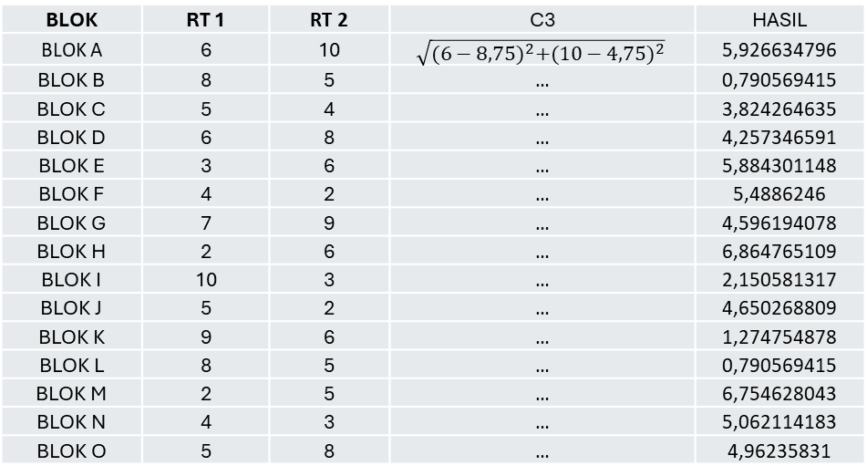
PENGELOMPOKKAN DATA CENTROID BARU
CENTROID | RT 1 | RT 2
CENTROID BARU 3 | 8,75 | 4,75
BLOK | RT 1 | RT 2 | C3 | HASIL
BLOK A | 6 | 10 | $$\sqrt{{(6−8,75)}^{2}+{(10−4,75)}^{2}}$$ | 5,926634796
BLOK B | 8 | 5 | … | 0,790569415
BLOK C | 5 | 4 | … | 3,824264635
BLOK D | 6 | 8 | … | 4,257346591
BLOK E | 3 | 6 | … | 5,884301148
BLOK F | 4 | 2 | … | 5,4886246
BLOK G | 7 | 9 | … | 4,596194078
BLOK H | 2 | 6 | … | 6,864765109
BLOK I | 10 | 3 | … | 2,150581317
BLOK J | 5 | 2 | … | 4,650268809
BLOK K | 9 | 6 | … | 1,274754878
BLOK L | 8 | 5 | … | 0,790569415
BLOK M | 2 | 5 | … | 6,754628043
BLOK N | 4 | 3 | … | 5,062114183
BLOK O | 5 | 8 | … | 4,96235831

Slide 12
PENGELOMPOKKAN DATA CENTROID BARU
BLOK | RT 1 | RT 2 | C1 | C2 | C3 | CENTROID BARU
BLOK A | 6 | 10 | 6,472863291 | 1,25 | 5,926634796 | 2
BLOK B | 8 | 5 | 4,540071023 | 4,25 | 0,790569415 | 3
BLOK C | 5 | 4 | 1,428571429 | 4,85412196 | 3,824264635 | 1
BLOK D | 6 | 8 | 4,67952553 | 0,75 | 4,257346591 | 2
BLOK E | 3 | 6 | 2,080031397 | 4,069705149 | 5,884301148 | 1
BLOK F | 4 | 2 | 2,045403009 | 7,04006392 | 5,4886246 | 1
BLOK G | 7 | 9 | 6,062598621 | 1,030776406 | 4,596194078 | 2
BLOK H | 2 | 6 | 2,543499116 | 4,85412196 | 6,864765109 | 1
BLOK I | 10 | 3 | 6,505884307 | 7,004462863 | 2,150581317 | 3
BLOK J | 5 | 2 | 2,457807219 | 6,823672032 | 4,650268809 | 1
BLOK K | 9 | 6 | 5,785273352 | 4,069705149 | 1,274754878 | 3
BLOK L | 8 | 5 | 4,540071023 | 4,25 | 0,790569415 | 3
BLOK M | 2 | 5 | 1,862629259 | 5,48292805 | 6,754628043 | 1
BLOK N | 4 | 3 | 1,087967587 | 6,087897831 | 5,062114183 | 1
BLOK O | 5 | 8 | 4,247448214 | 1,25 | 4,96235831 | 2

Slide 13
MEMPERBARUI CENTROID
CENTROID LAMA | RT 1 | RT 2
C1 | 3,571428571 | 4
C2 | 6 | 8,75
C3 | 8,75 | 4,75
CENTROID BARU | RT 1 | RT 2
C1 | 3,571428571 | 4
C2 | 6 | 8,75
C3 | 8,75 | 4,75
C1X = $\frac{1}{7}\left(5+3+4+2+5+2+4\right)=3,571428571$
C1Y = $\frac{1}{7}\left(4+6+2+6+2+5+3\right)=4$
C2X = $\frac{1}{4}\left(6+6+7+5\right)=6$
C2Y = $\frac{1}{4}\left(10+8+9+8\right)=8,75$
C3X = $\frac{1}{4}\left(8+10+9+8\right)=8,75$
C3Y = $\frac{1}{4}\left(5+3+6+5\right)=4,75$
NILAI CENTROID SUDAH SAMA

